Slide 1


Slide 2




Problem
90%
LIMITED ACCESS TO INFORMATION
UNEQUAL OPPORTUNITIES

Slide 3


Existing Products
Expensive

Slide 4




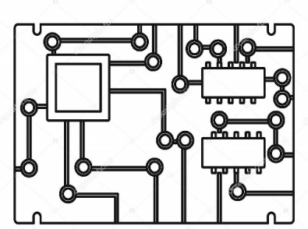

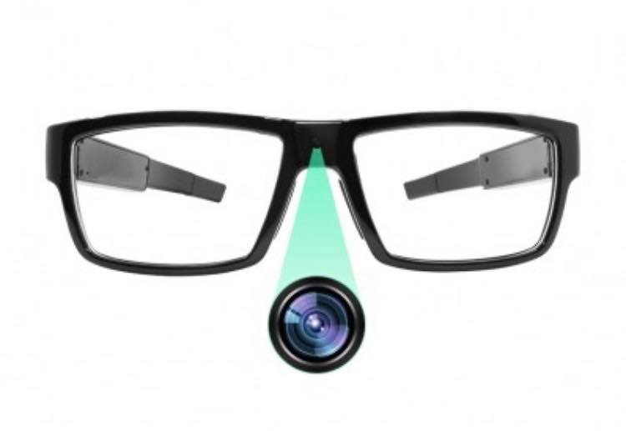

Solution

Slide 5



Our Product

Slide 6



Slide 7

Handwriting

Slide 8
90%
less expensive

Slide 9
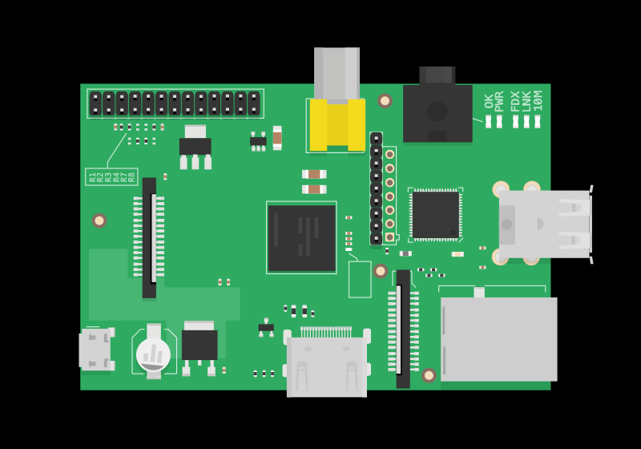


Used technologies
Execution on Raspberry Pi 3’ CPU
Text-To-Speech API
Handwriting-Recognition OCR API

Slide 10
Technology demonstration

Slide 11
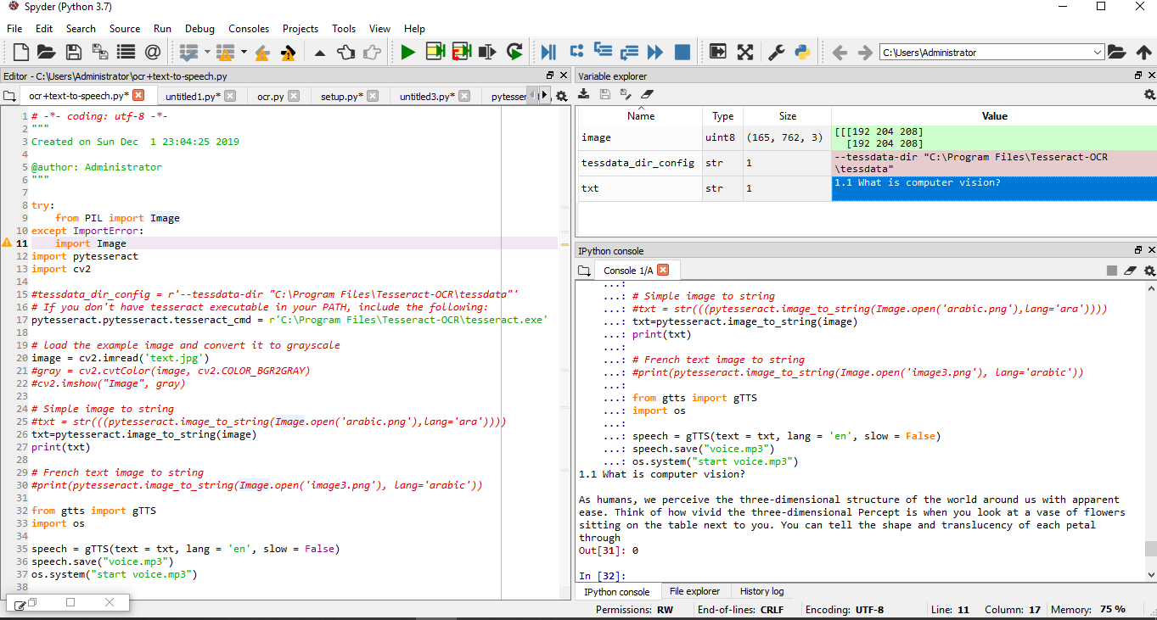
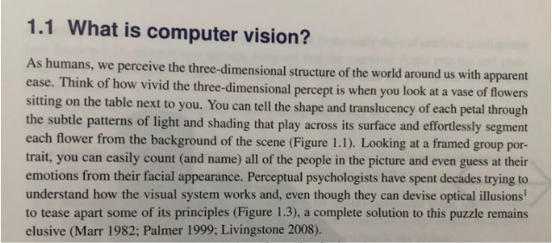

Technology demo

Slide 12
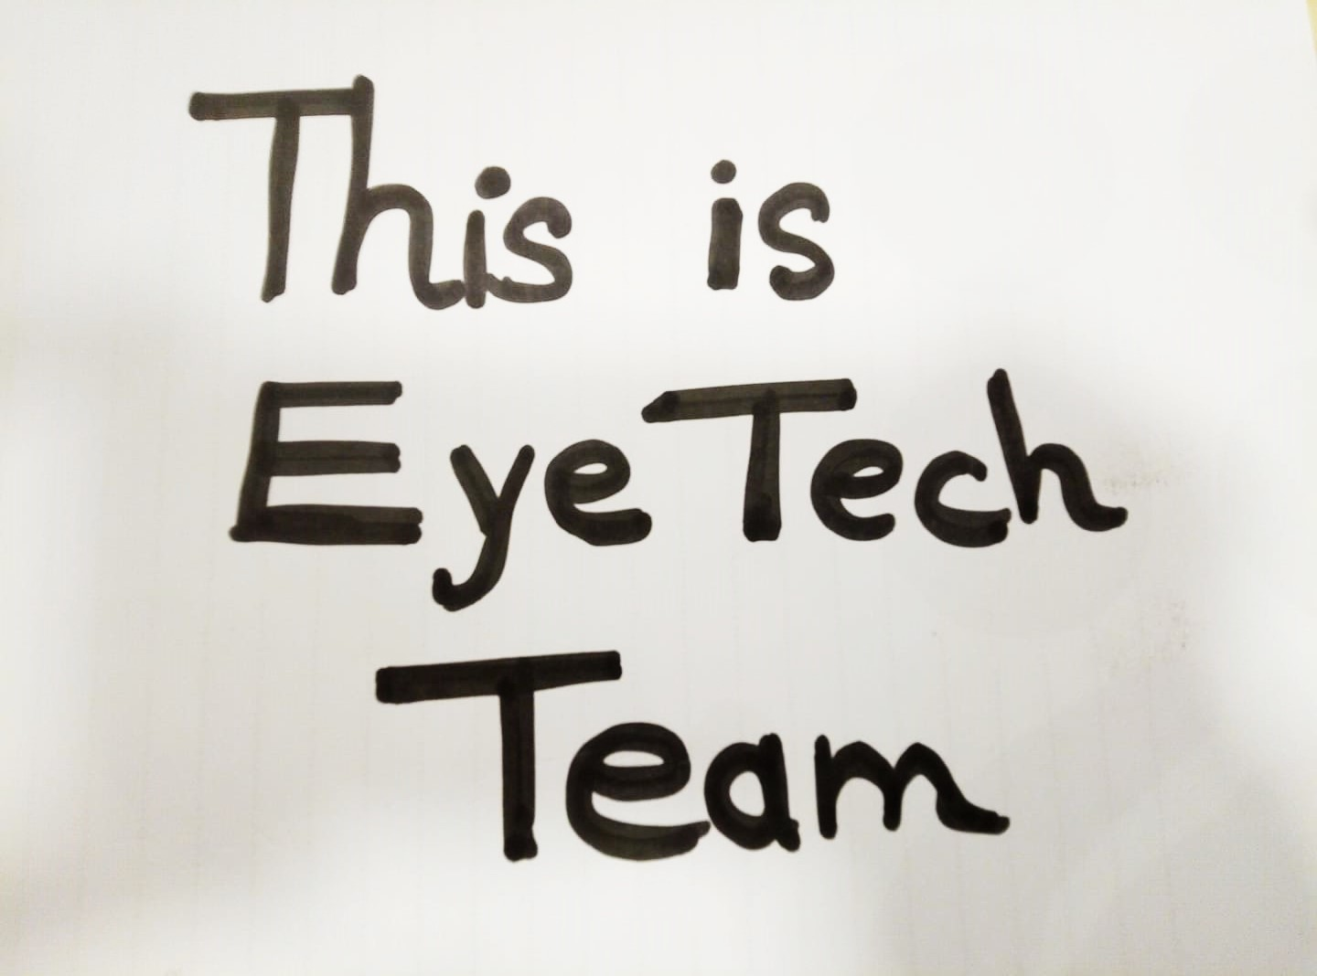

Slide 13
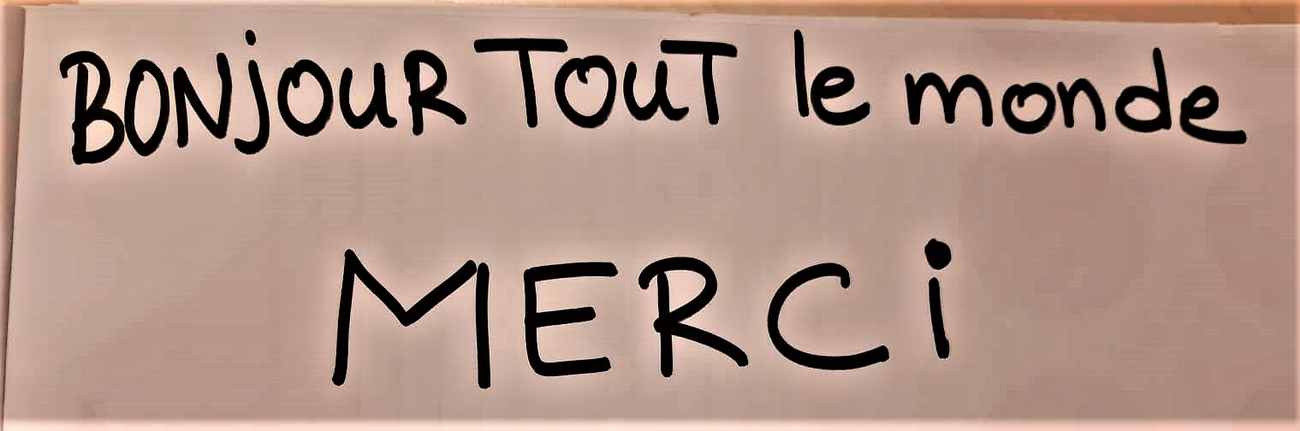

Slide 14
What about the market ?

Slide 15
Market size: visually disabled
Global
MENA
Tunisia
225M people
(588M in 2050)
30M people
224 000 people

Slide 16
Market discovery
53 interviews

Slide 17

3 different regions
Nabeul
Gabes
Tunis

Slide 18



Who are they ?
Doctors
Teachers
Students

Slide 19




Strategic partners and market insights

Slide 20



Our impact
High education
Suitable job
Social inclusion

Slide 21
Let’s talk Business !

Slide 22

Revenue model
Product
420 TND
Costs
210 TND
Gross margin
50%
Number of sales/year
250
Turnover 105 000 TND
Charges 52 500 TND
Gross profit 52 500 TND/Year

Slide 23






Distribution
Consumer
Consumer
Consumer

Slide 24








Competitive landscape
Price (USD) | $5000 | $5995 | $3250 | $5950 | $149
Text recognition
Arabic language
Accessibility in Tunisia

Slide 25

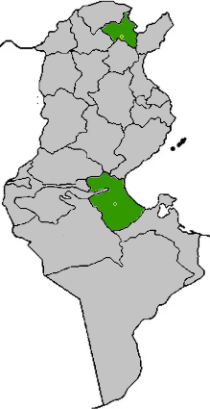
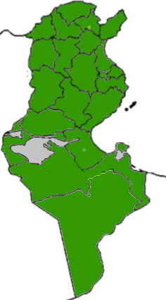
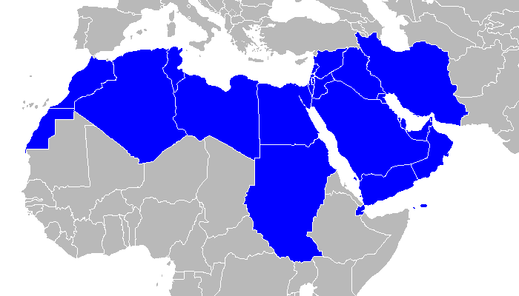
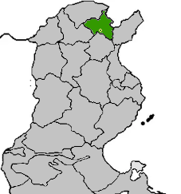






Scalability
3 months
1 year
3 years
5 years

Slide 26
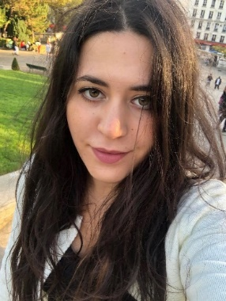
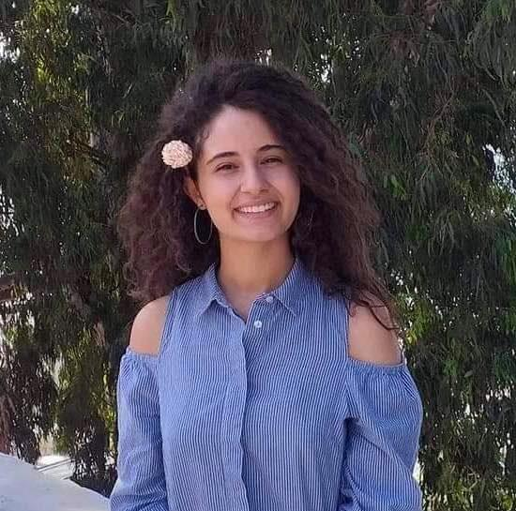
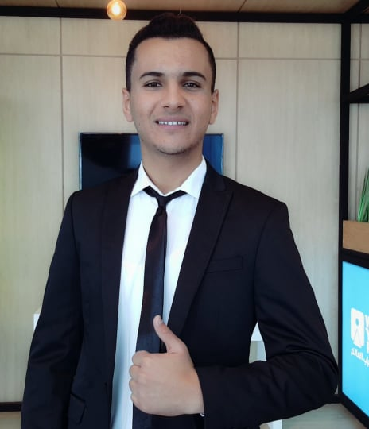
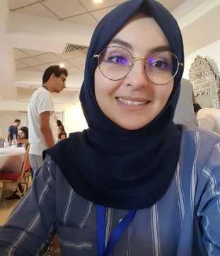
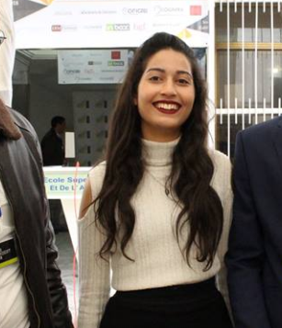
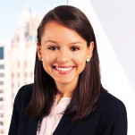
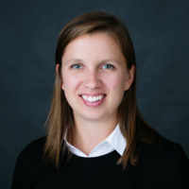
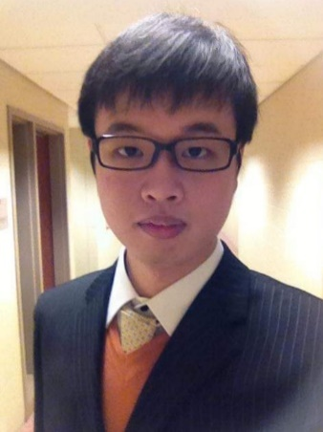
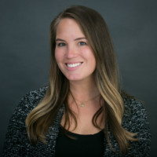
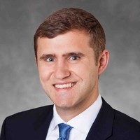
Our team
Aysser Miled
Business graduate and researcher in international finance
Omayma Farhat
Accounting student
Nader Thabet
Maintenance of industrial systems student
Samar Chebbi
ICT Engineering student Sup’Com
Olfa Jerbi
Statistics and data reconfiguration student
Claire Biernacki
Columbia Business School, Class of 2020
Background: Investment Banking/ Venture Capital
Halley McDaniel
Columbia Business School, Class of 2020
Background:
Human Resources/ Recruiting
SeonJin Kim
Columbia Business School, Class of 2020
Background: Corporate Credit
Shayla Campbell
Columbia Business School, Class of 2020
Background:
Social Impact/ Marketing
Tim Lynch
Columbia Business School, Class of 2020
Background:
Private Equity/ Venture Capital

Slide 27
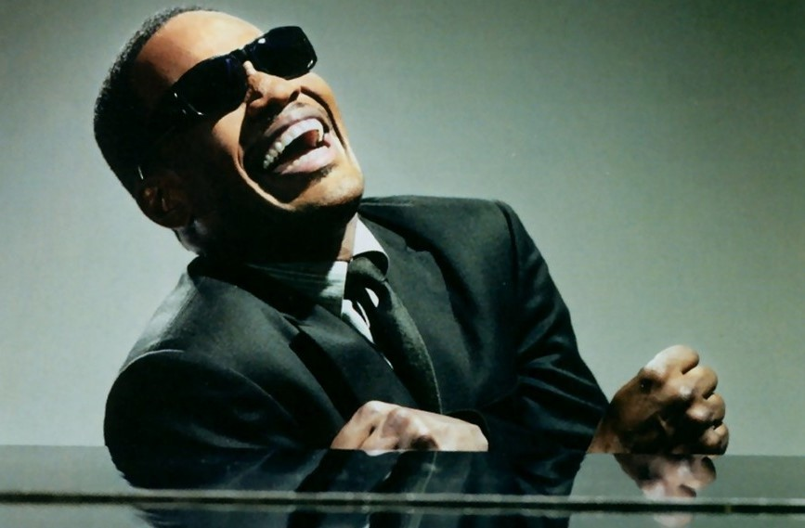
THANK YOU

Slide 28
Financial model

Slide 29




Tech roadmap
Translation
Object detection
Lower price

Slide 30


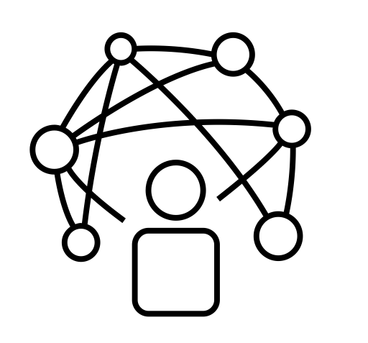
Marketing strategy
Campaigns in schools
Partnerships with ministries
Partnerships with
organizations
Community management (Facebook, instagram, messenger)

Slide 31



Market insights

Slide 32
